Slide 1
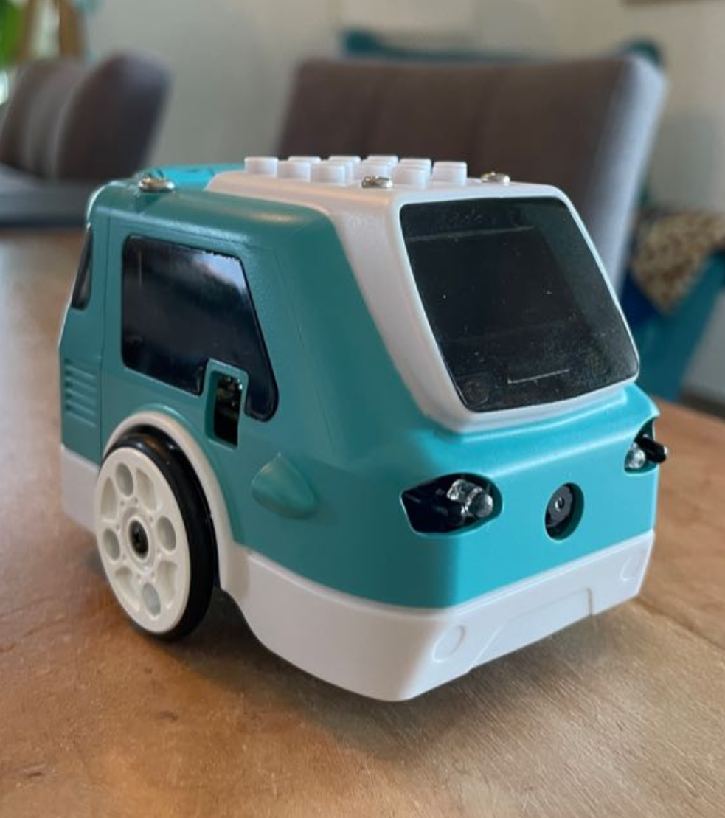
Zumi 7337
Team presentation
Simone Wullschleger
Mykhailo Andrusiak
Lea Schönauer

